Slide 1
Kiana Final Presentation
Los Angeles Consulting Group (LACG)
Notes:
Good afternoon everyone
We are Los Angeles Consulting Group.
We’d like to take this opportunity to present our company's project

Slide 2
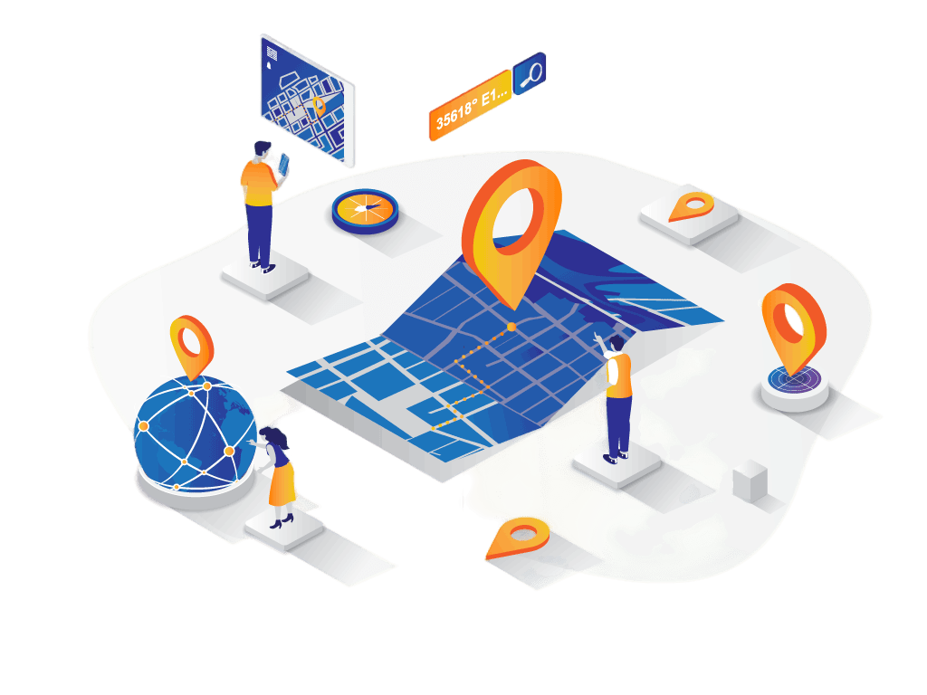
Agenda
Security Values
Data Exploration
Optimizing Security
Maintenance Issue
Conclusion
Notes:
During this presentation
We’ll help you understand the issue we are trying to solve.
highlight the benefits of our solution
And then will go into the details of how our solution works and the method behind that.
Lastly we will share our future plans
let's get started with the first topic
Lastly, we will open up the floor for any questions you may have
So let's get started with the first topic

Slide 3
Turning Alarming Statistics into Action: Building an Optimized Security Solution to Protect Your Business from Data Breaches.
From Thales Data Threat Report,
In 2022, 45% of US companies
have experienced a data breach
Storage Giant, Western Digital,
Suffers a Security Breach, Denying Cloud Customers Access to Their Data
GoDaddy Reveals
Multi-Year Cybersecurity Campaign
by Sophisticated Threat Actor,
Including Malware Installation and Source Code Breach.
Notes:
https://www.comparitech.com/blog/vpn-privacy/data-breach-statistics-facts/
https://www.cpomagazine.com/cyber-security/storage-giant-western-digital-suffers-a-security-breach-denying-cloud-customers-access-to-their-data/
https://www.securityweek.com/godaddy-says-recent-hack-part-of-multi-year-campaign/
Security is the importance in business. Many Assets must be protected including intellectual property and sensitive information
Let thinking about the assets is loss. The business will face various impacts
including Loss of competitive advantage, trust, reputation and can lead to fines and legal battles.
Therefore, it is more important than ever to have strong security measures
However, implementing security protocols can often be complex and time-consuming

Slide 4






Security Strategy Can Benefit Your Business
Beyond Protection
Security Optimization
Protect Sensitive Information
Maintenance
Maintain Customer Trust
Reduce Security Risk
Energy Saving
Notes:
Security is the importance in business. Many Assets must be protected including intellectual property, customer information and financial information
Let thinking about the assets is loss. The business will face various impacts
including Loss of competitive advantage, trust, reputation and can lead to fines and legal battles.
Security Strategy Can Benefit Your Business Beyond Protection
Our prototype helps companies to protect their sensitive information from being stolen by tracking unauthorized access.
This helps in maintaining the trust of their customers as they expect their personal and confidential information to be protected.
It also reduces the risk of security breaches.
Beyond protection, the security optimization approaches can discover the benefit of maintenance and energy saving that we will demonstrate to all of you today.
These approaches ensures that customer are not only feel confident that their valuable assets are safe and secure. ,
but also having efficient workflows and long-term cost-effective

Slide 5
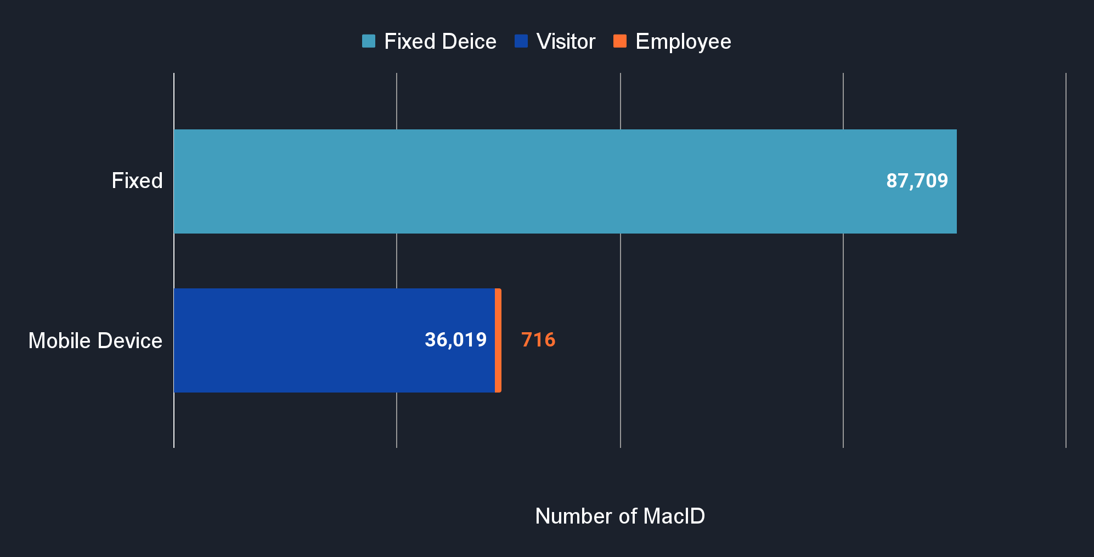
Data Preparation Reveals the Distribution of Device Types for Improved Decision Making.
Device type distribution based on standard deviation distance
The 124,444 unique Mac ID presenting From 2019-08-12 UTC to 2020-09-01 UTC
Notes:
Data preparation can improve decision making by revealing the distribution of device type, as shown in the graph. By using standard deviation distance approach, we can divide the Mac ID dataset into 88,000 fixed devices and 37,000 mobile devices, which can further be separated the Mac ID into visitor and employee using the assumption that the MacID
showing less than 59 days in be 36,000 visitors and more than 59 days to be 700 employees. This information can help us develop effective strategies for our business.

Slide 6
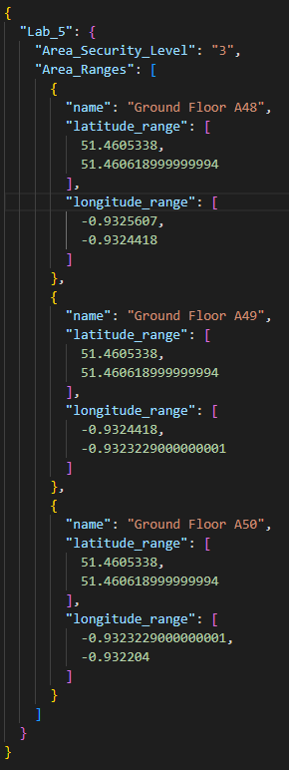
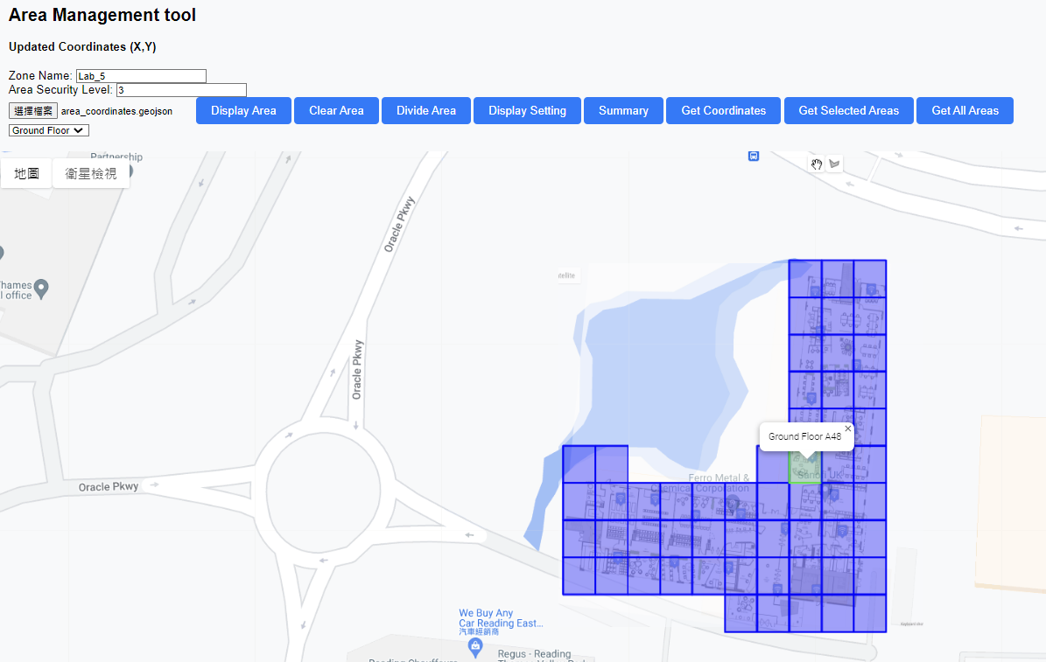
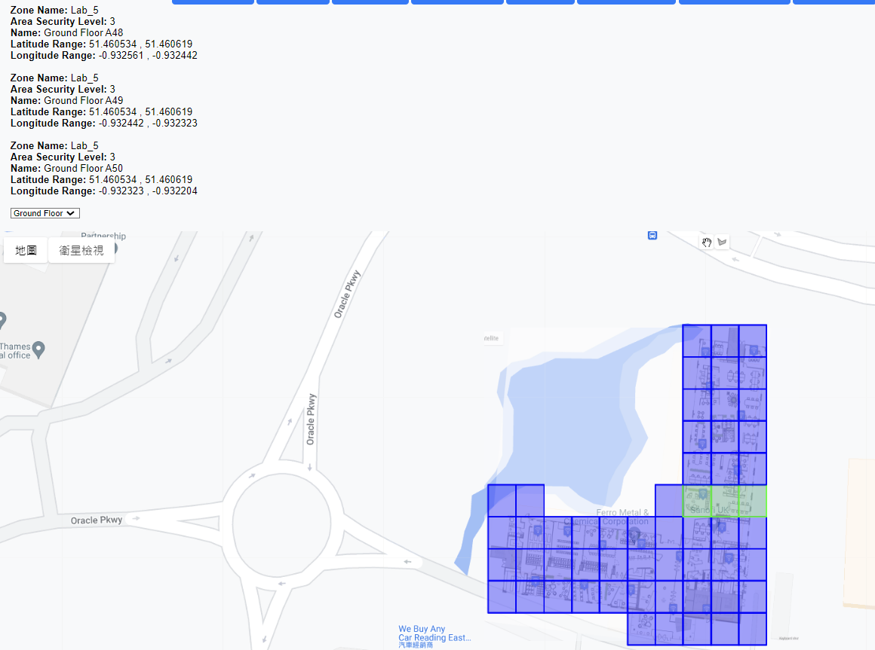
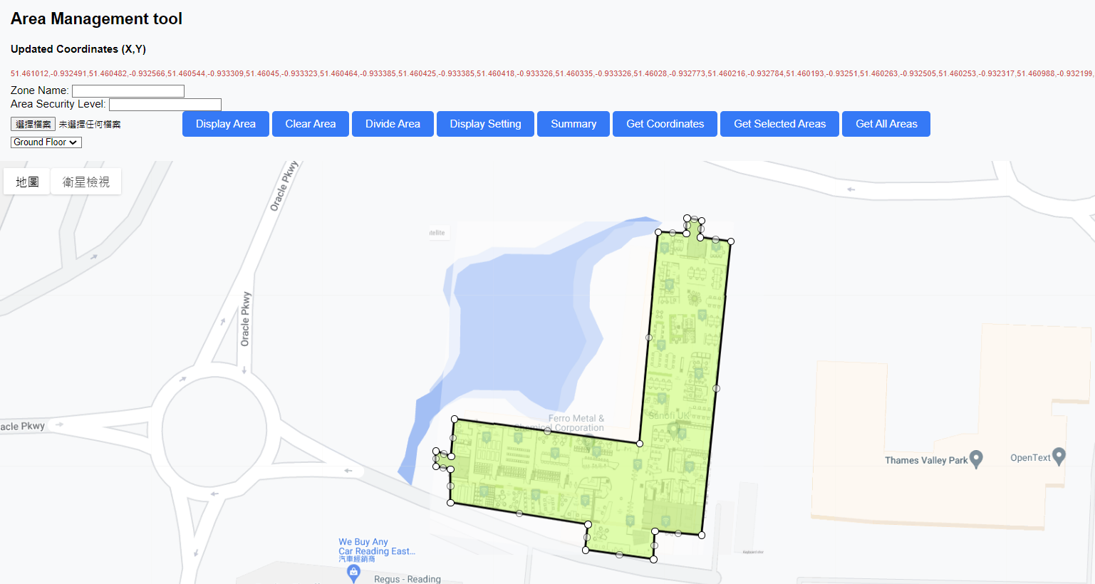
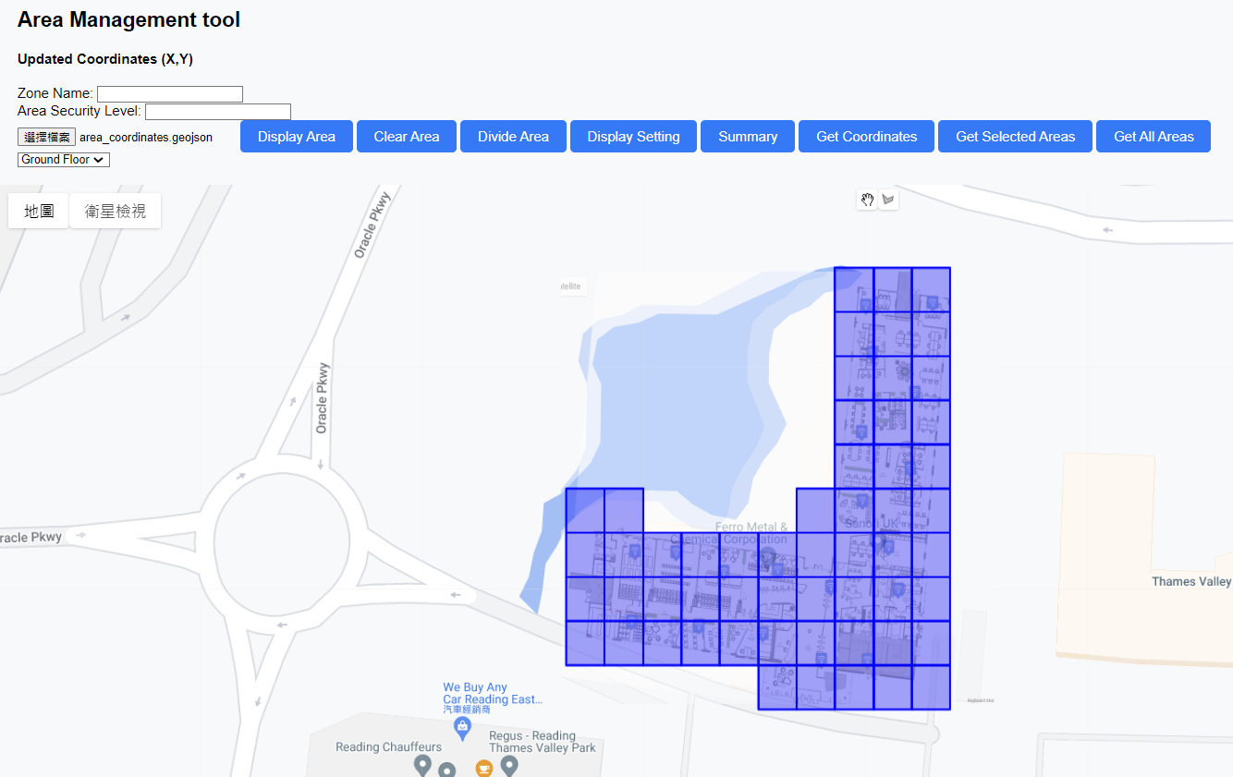
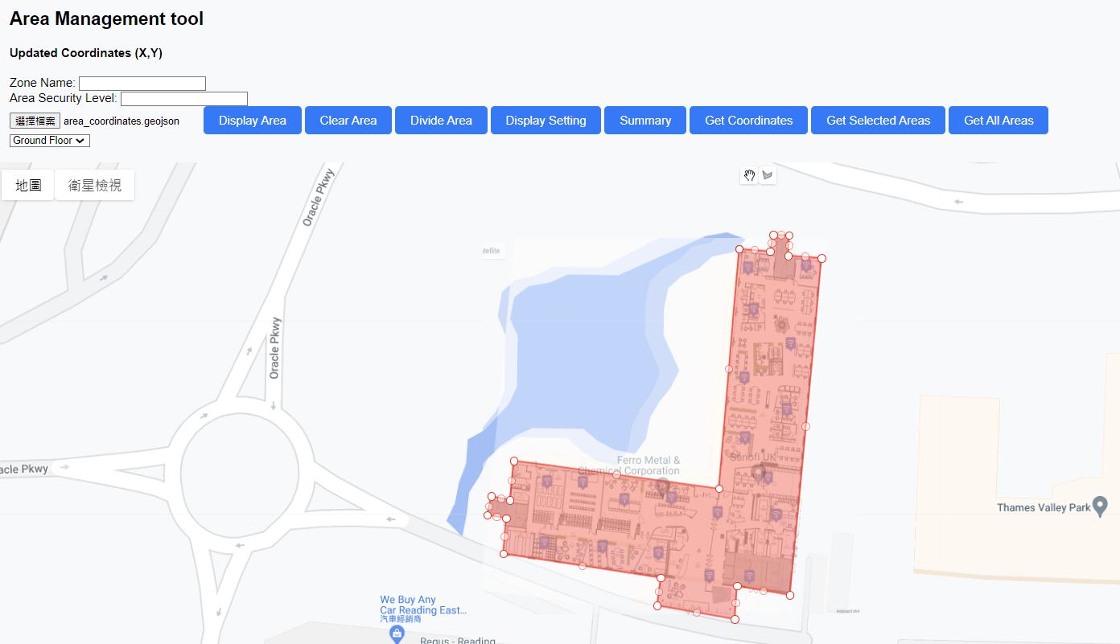
Achieving Optimal Security Zones through Effective Planning
Area
Determine the security zone to 5 levels
Draw area on map
Draw area on map
Retrieve coordinate
Retrieve coordinate
Loading file
Loading file
Divide area to grid
Divide area to grid
Select the grid
Select the grid
Display setting
Display setting
Get selected area
Get selected area
Notes:
Determine the area of security zone to 5 levels from 3 options
Customization the shape
Selecting the grid
Loading the location file
Step retrieve all the coordinate information,
Loading file is to open the information that we saved last time. It can avoid the manually error(think about that)

Slide 7
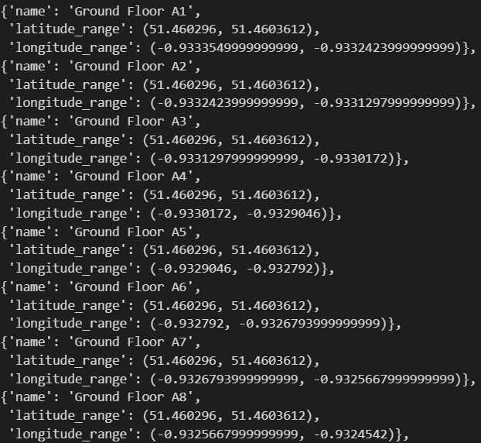
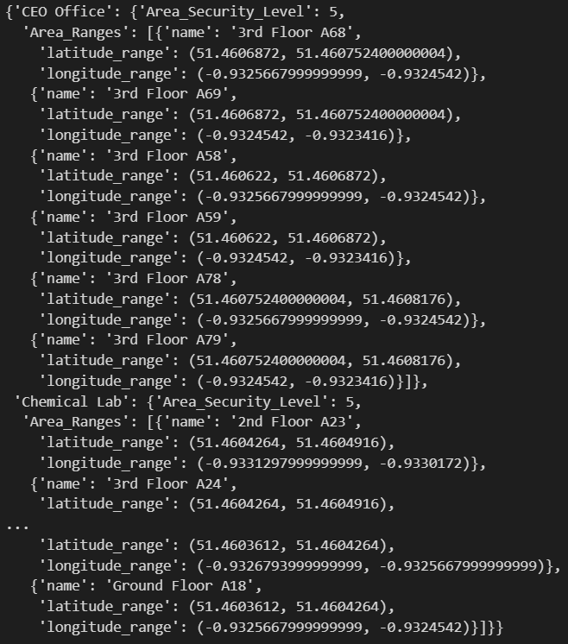
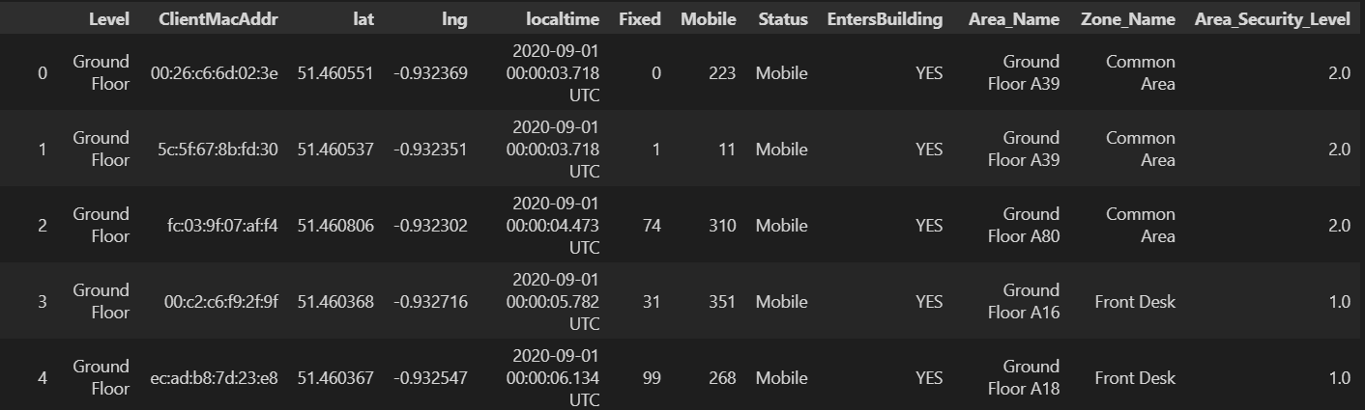
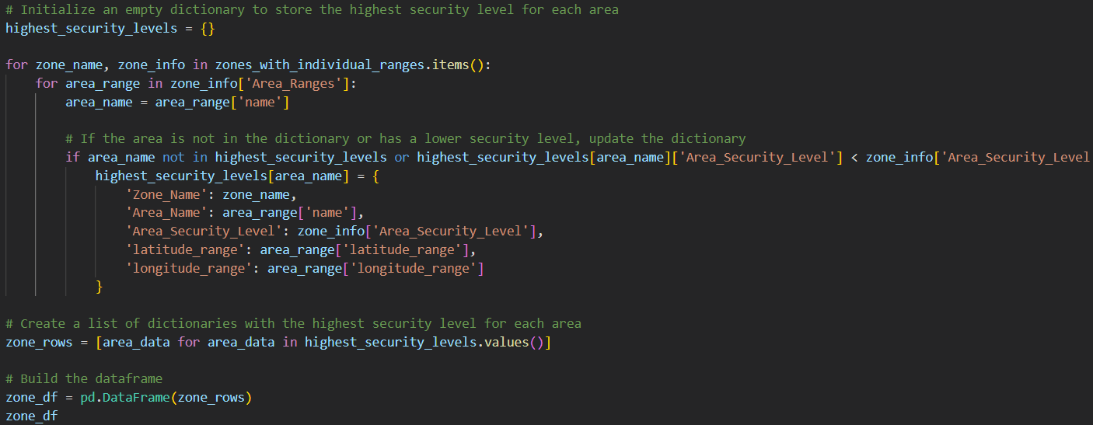
Achieving Optimal Security Zones through Effective Planning
Area
People
Alert!
Notes:
Assign area name and zone name to employee’s data from Kiana
Prepare to 2 data frame:
(left corner pic) all area from website
(left corner pic 2) selected area from website
Merge two by coding, the result is the first dataframe
2. Kian’s data
-> result

Slide 8
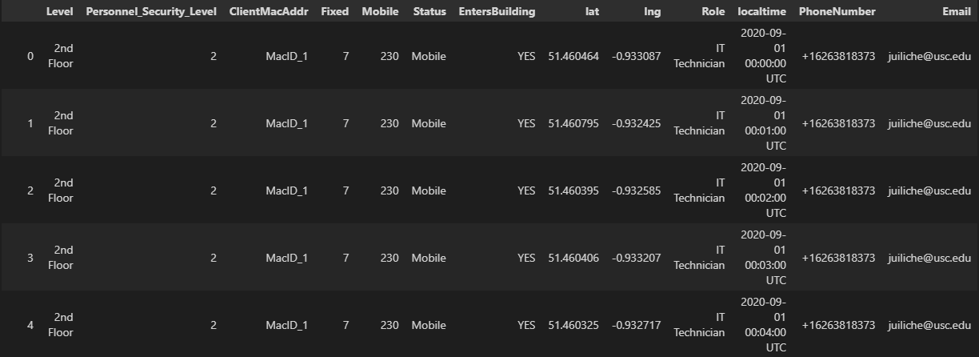
Achieving Optimal Security Zones through Effective Planning
Area
People
Alert!
Assign job responsibilities to each security zone level
Notes:
Make employee dataset to simulate the real-world situation:

Slide 9
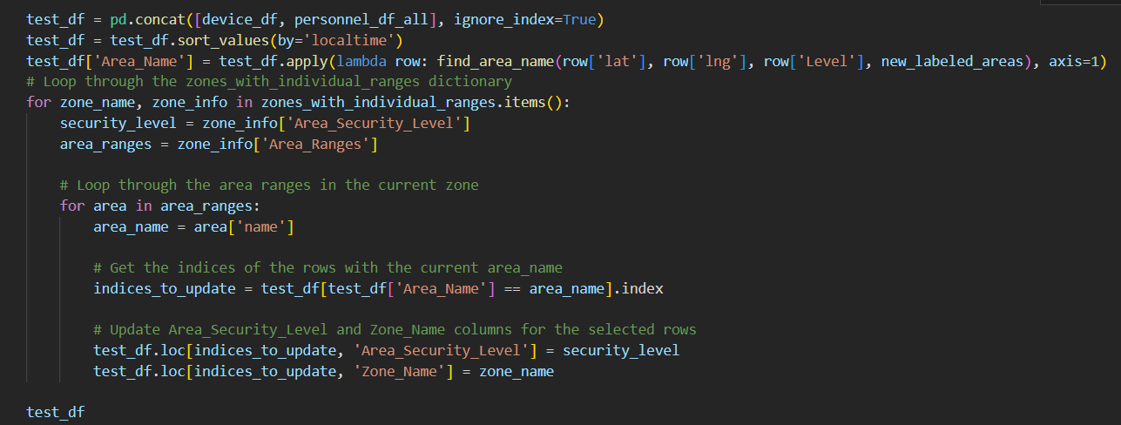
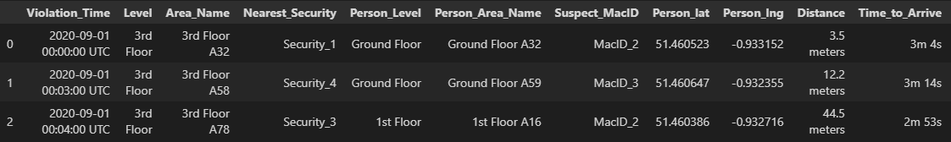
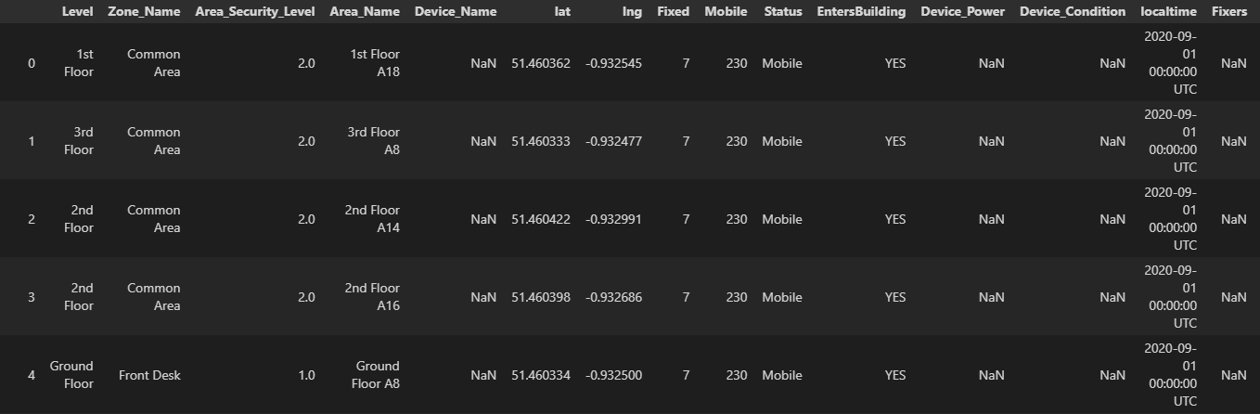
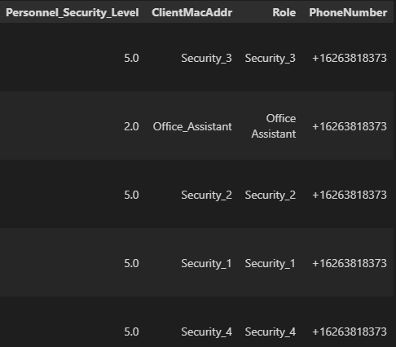
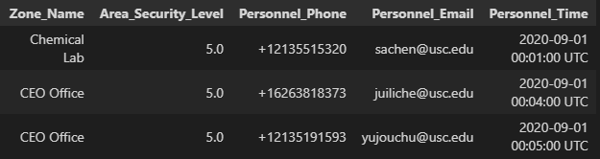
Achieving Optimal Security Zones through Effective Planning
Area
People
Alert!
Event Information
Personal Information
Calculation
Notes:
Compared employee security level with zone security level, when zone security level is higher than employee’s

Slide 10
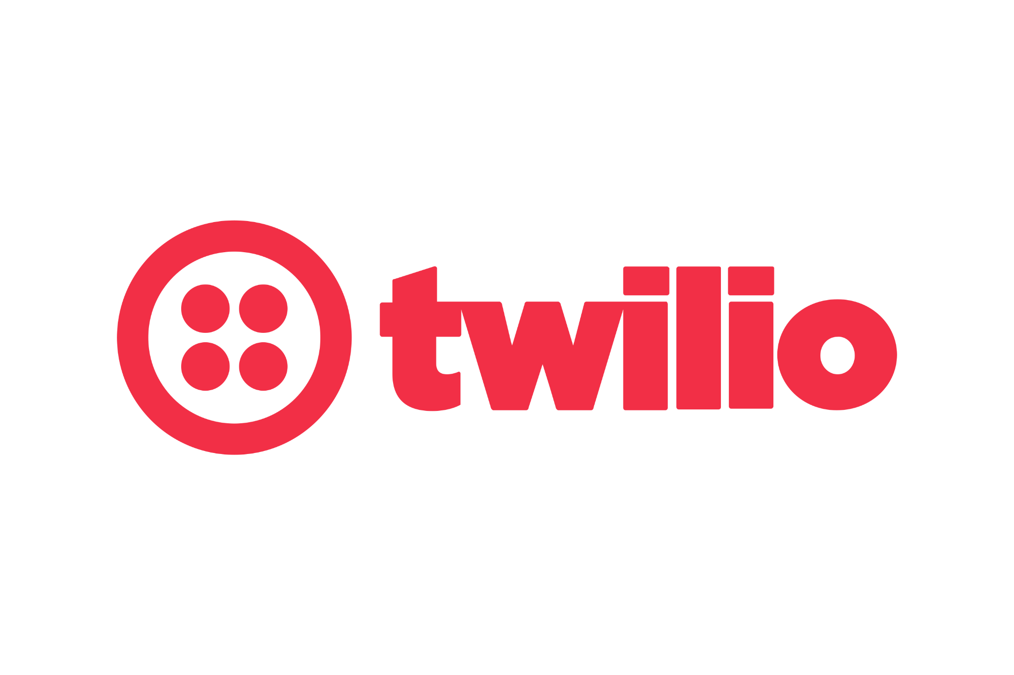

Demo time!
Experience the Power of Optimal Security
Notes:
Here I am going to talk about how we did to implement our security zone, We provides two different approaches to let our customers to use either one they like, the one they believe suites their needs the most. First we have Function1: this function let customers to draws their security zones manually in any shape, these security zones can be changed any time clients wants, and label their functions, we believe this approach gives the customers

Slide 11
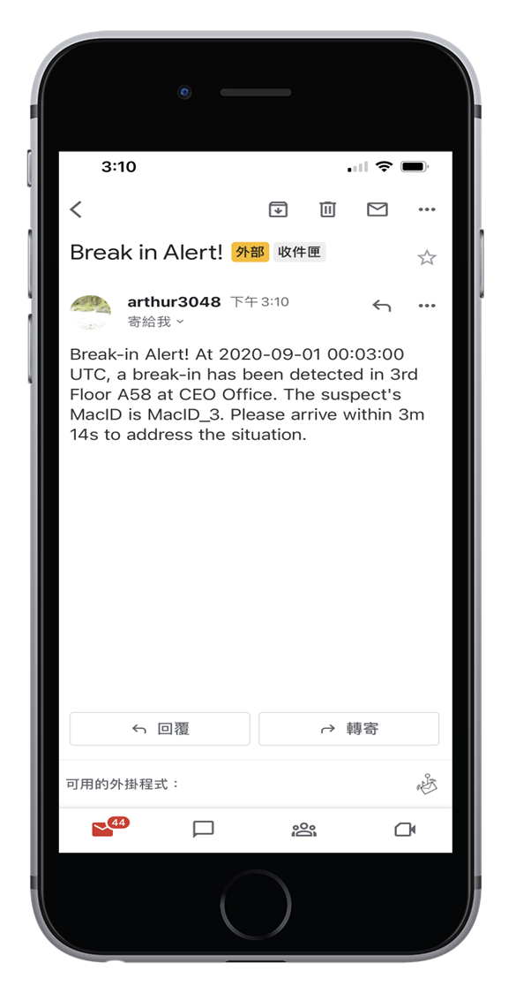
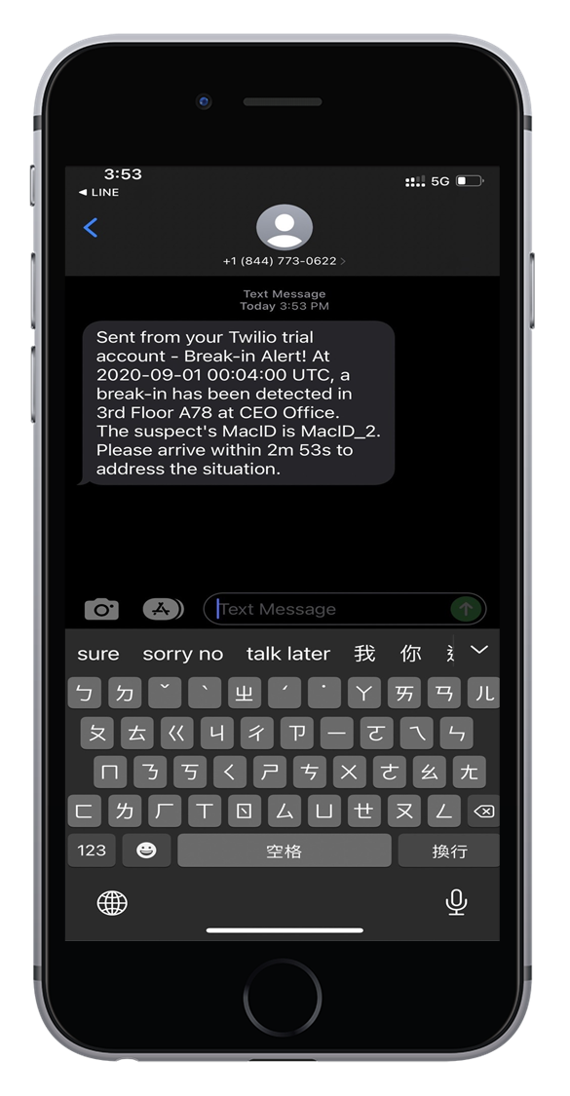
Demo time!
Notes:
Here I am going to talk about how we did to implement our security zone, We provides two different approaches to let our customers to use either one they like, the one they believe suites their needs the most. First we have Function1: this function let customers to draws their security zones manually in any shape, these security zones can be changed any time clients wants, and label their functions, we believe this approach gives the customers

Slide 12
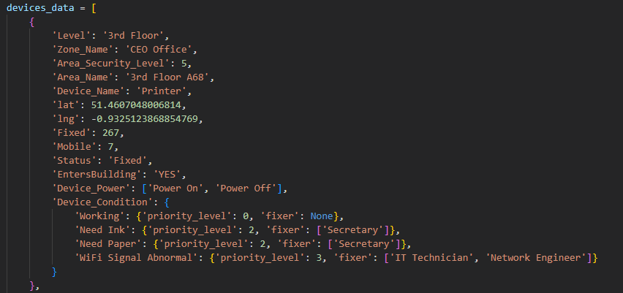
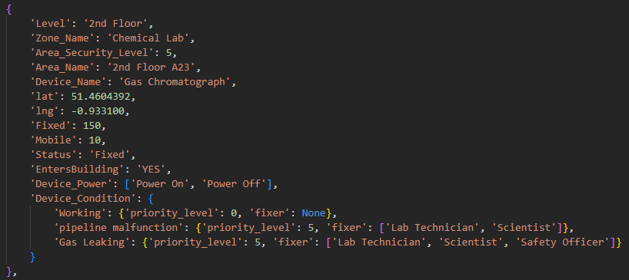
Achieving Extra Value of Maintenance through Effective Planning of Your Security Strategy
Area
Device Vs People
Achieving area from Optimize Security zone
Assign job responsibilities to Device and maintenance tasks

Slide 13
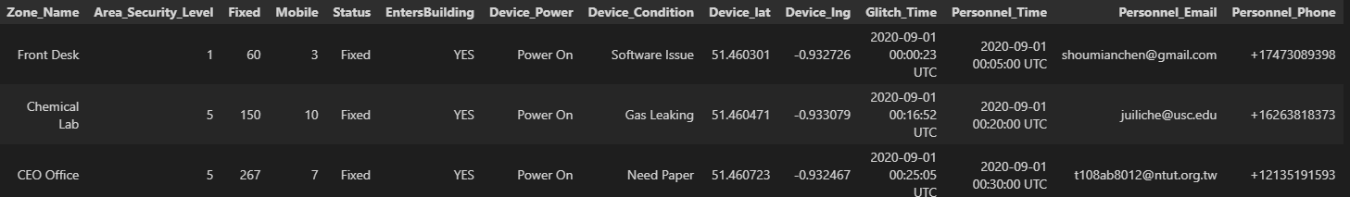
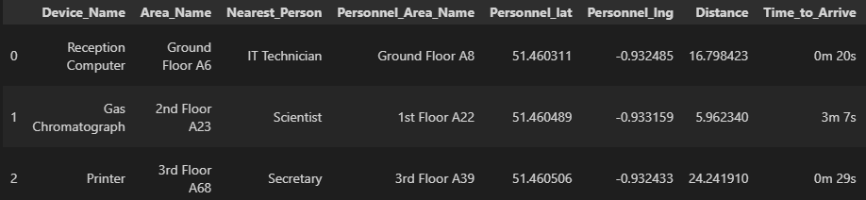
Maintenance Results Can Increase Overall Operational Efficiency
Area
Device Vs People
Alert!
Event Information
Device Information
Personnel Information
Calculation

Slide 14
Demo time!
Experience the Power of Managing Maintenance
Notes:
Here I am going to talk about how we did to implement our security zone, We provides two different approaches to let our customers to use either one they like, the one they believe suites their needs the most. First we have Function1: this function let customers to draws their security zones manually in any shape, these security zones can be changed any time clients wants, and label their functions, we believe this approach gives the customers

Slide 15
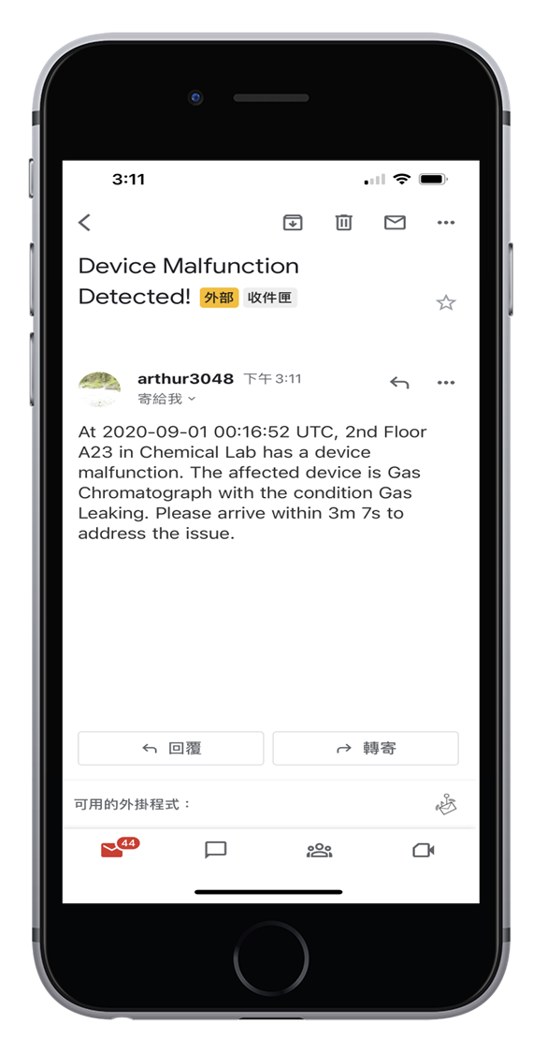
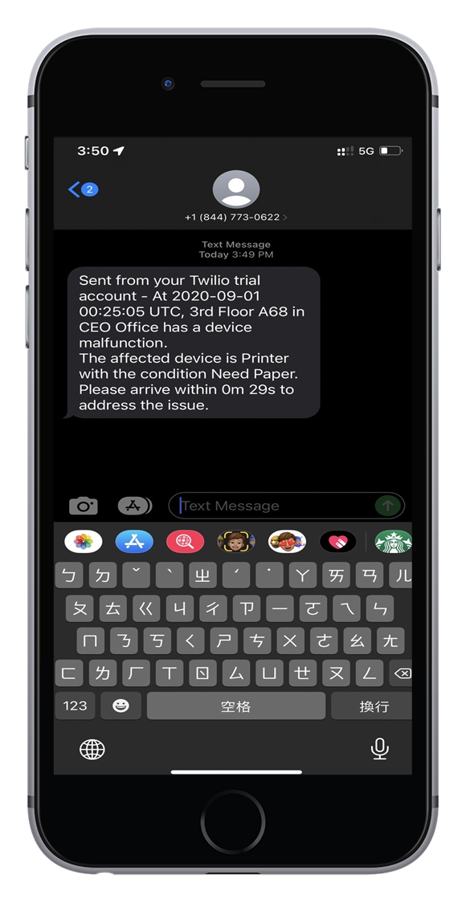
Demo time!
Notes:
Here I am going to talk about how we did to implement our security zone, We provides two different approaches to let our customers to use either one they like, the one they believe suites their needs the most. First we have Function1: this function let customers to draws their security zones manually in any shape, these security zones can be changed any time clients wants, and label their functions, we believe this approach gives the customers

Slide 16
The Power of Optimized Security Strategies and Effective Maintenance Planning for Maximum Protection and Efficiency.
Security Optimization
Maintenance
Notes:
Here I am going to talk about how we did to implement our security zone, We provides two different approaches to let our customers to use either one they like, the one they believe suites their needs the most. First we have Function1: this function let customers to draws their security zones manually in any shape, these security zones can be changed any time clients wants, and label their functions, we believe this approach gives the customers
By partnering with us, These approaches ensures that customer are not only feel confident that their valuable assets are safe and secure.
, but also having efficient workflows and long-term cost-effective

Slide 17
Thank You
Q&A

